Slide 1
Various camera configurations
Single point of fixation where optical axes intersect
Optical axes parallel (fixation at infinity)
General case

Slide 2
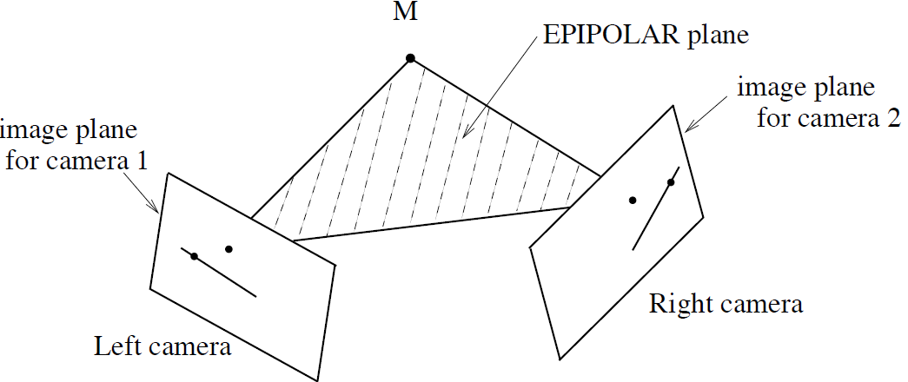
Epipolar geometry for cameras in general position

Slide 3
Epipolar geometry for cameras in general position

Slide 4
Epipolar geometry for cameras in general position

Slide 5
Epipolar geometry for cameras in general position

Slide 6
Epipolar geometry for cameras in general position

Slide 7
Epipolar geometry for cameras in general position

Slide 8
Epipolar geometry for cameras in general position

Slide 9
Epipolar geometry for cameras in general position

Slide 10
Applications
Reconstructing a three dimensional object given two or more photos. The relative orientation of the cameras is unknown, such as when using images downloaded from the internet, taken by different people at different times.
Some examples from Univ. Washington/Microsoft Research:
phototour.cs.washington.edu
photosynth.net
grail.cs.washington.edu/rome/

Slide 11
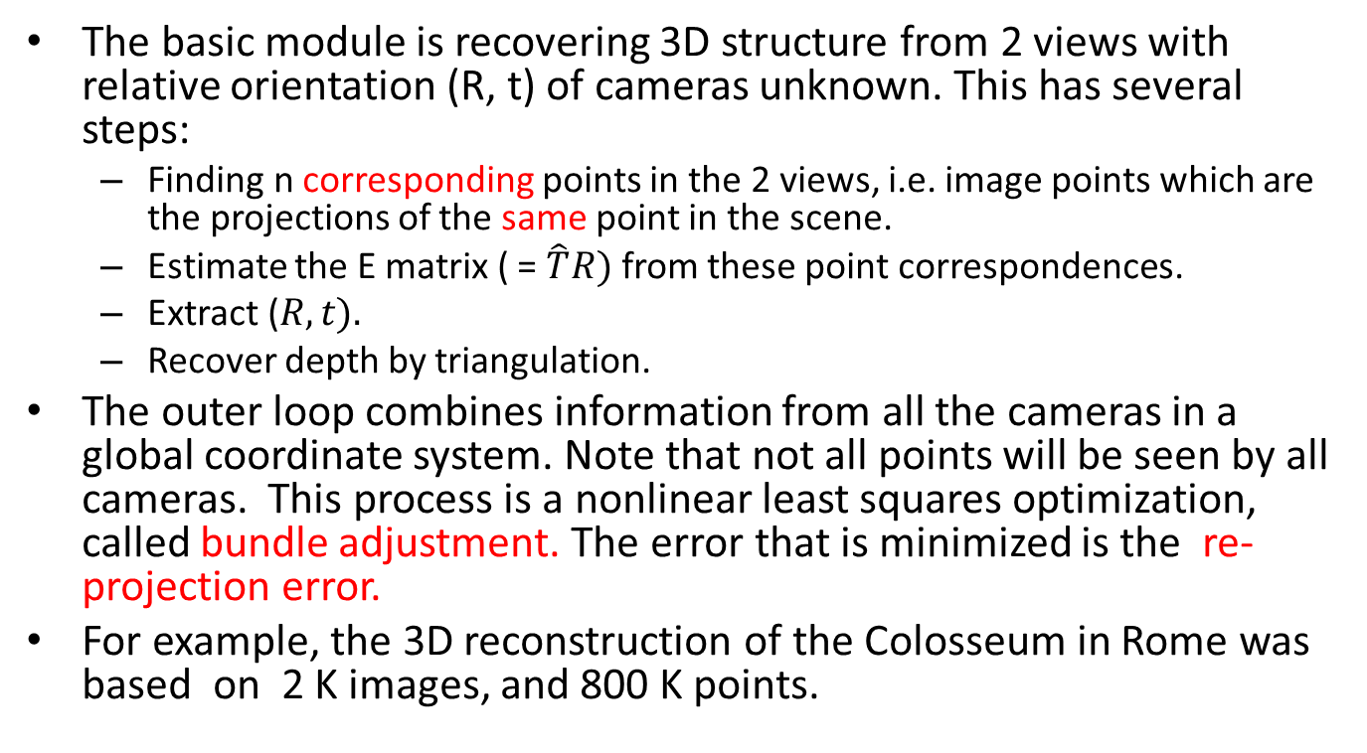
The approach

Slide 12
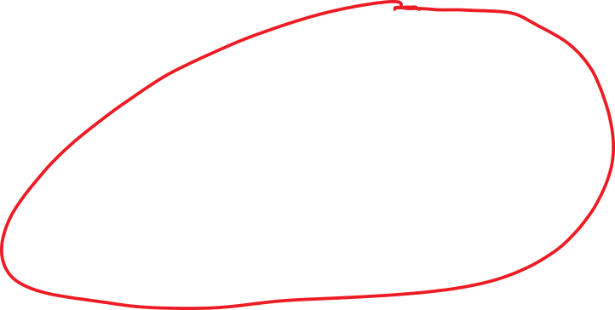
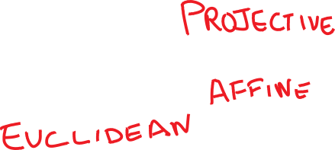
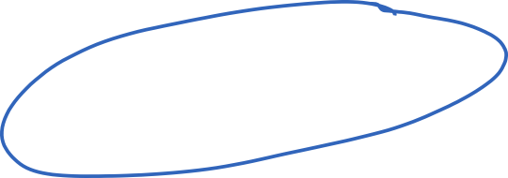

But first, let us review projective transformations

Slide 13
Projective Transformations
Under perspective projection, parallel lines can map to lines that intersect. Therefore, this cannot be modeled by an affine transform!
Projective transformations are a more general family which includes affine transforms and perspective projections.
Projective transformations are linear transformations using homogeneous coordinates

Slide 14
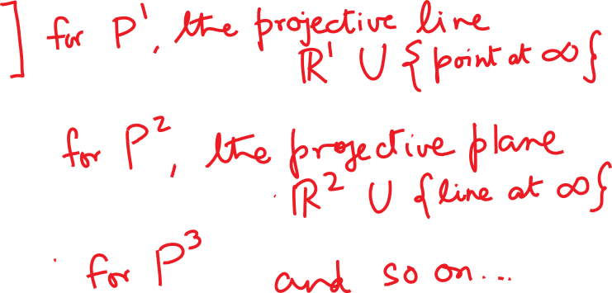
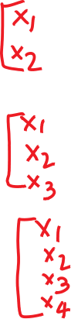

Homogeneous coordinates
Instead of using n coordinates for n-dimensional space, we use n+1 coordinates.

Slide 15

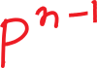


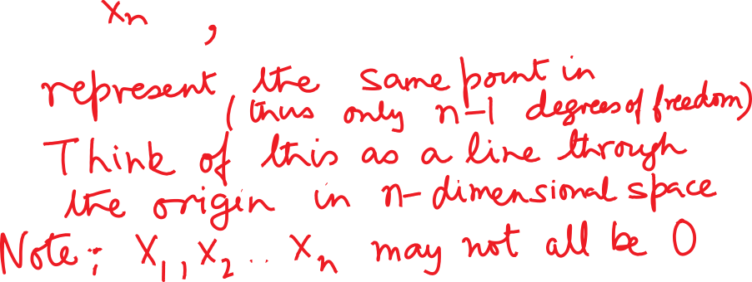
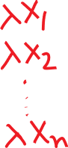



Key rule

Slide 16
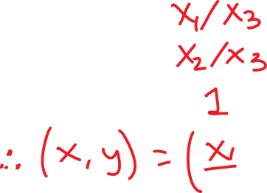

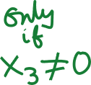




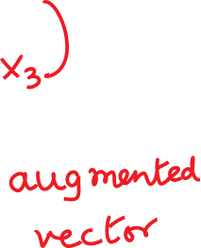
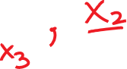





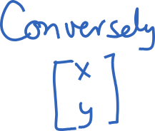
Picking a canonical representative

Slide 17
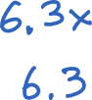
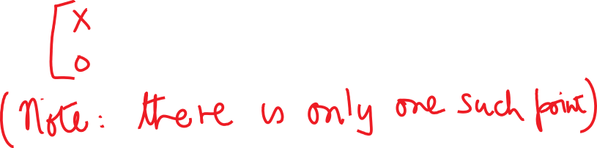

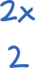



The projective line
Any finite point x can be represented as
Any infinite point can be expressed as

Slide 18
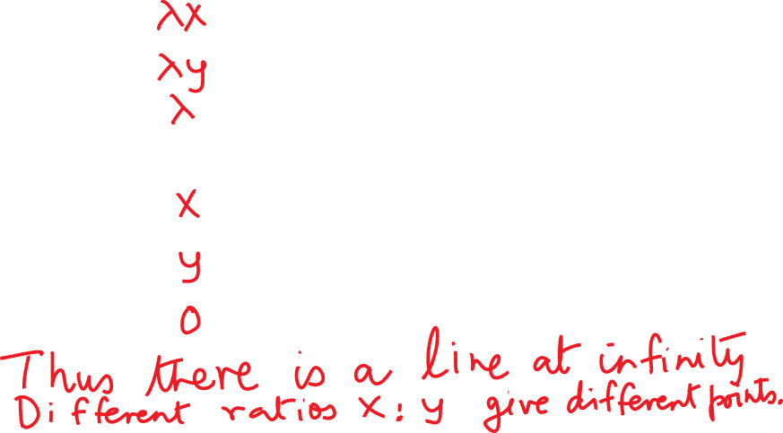


The projective plane
Any finite point can be represented as
Any infinite point can be represented as

Slide 19
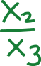

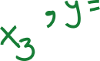
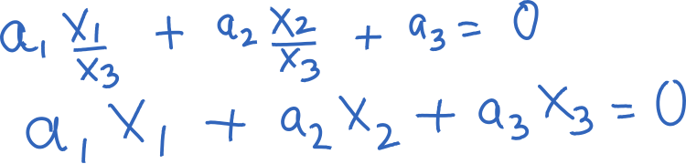
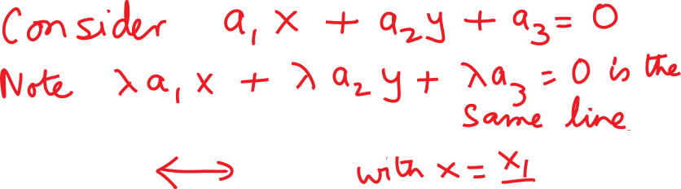



Lines in homogeneous coordinates

Slide 20

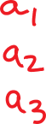


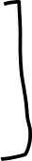
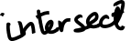
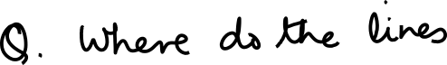
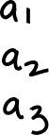

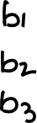


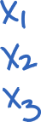
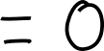
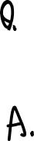
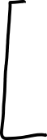


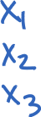

Incidence of points on lines

Slide 21
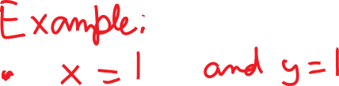
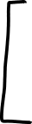
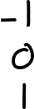
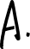
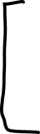
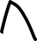
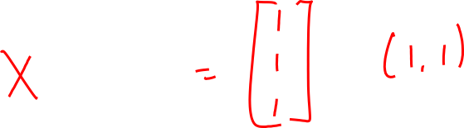

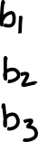
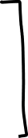
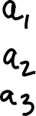
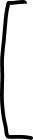
Incidence of points on lines

Slide 22
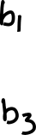


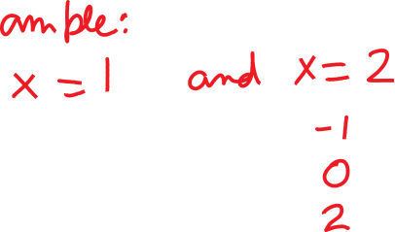
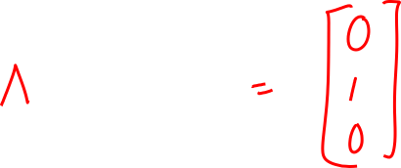
Incidence of points on lines

Slide 23






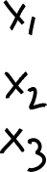
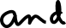





Line incident on two points

Slide 24





Representing affine transformations

Slide 25














Perspective Projection

Slide 26











Projective transformations

Slide 27
The Essential Matrix Constraint

Slide 28
Proof is based on the co-planarity of three rays

Slide 29
Coplanarity of 3-vectors implies triple product is zero

Slide 30

Longuet-Higgins 8 point algorithm

Slide 31
Summary
The basic module of recovering 3D structure from 2 views with relative orientation (R, t) of cameras unknown can be implemented using the Longuet-Higgins 8 point algorithm.
The outer loop combines information from all the cameras in a global coordinate system using bundle adjustment. The error that is minimized is the re-projection error. The big idea is that given the guessed 3d positions of a point, one can predict image plane 2d positions in any camera where it is visible. We wish to minimize the squared error between this predicted position and the actual position, summed over all cameras and over all points.
Lots of engineering has gone into making these approaches work. Read Szeliski’s book, Chapter 7, for more.

